Slide 1
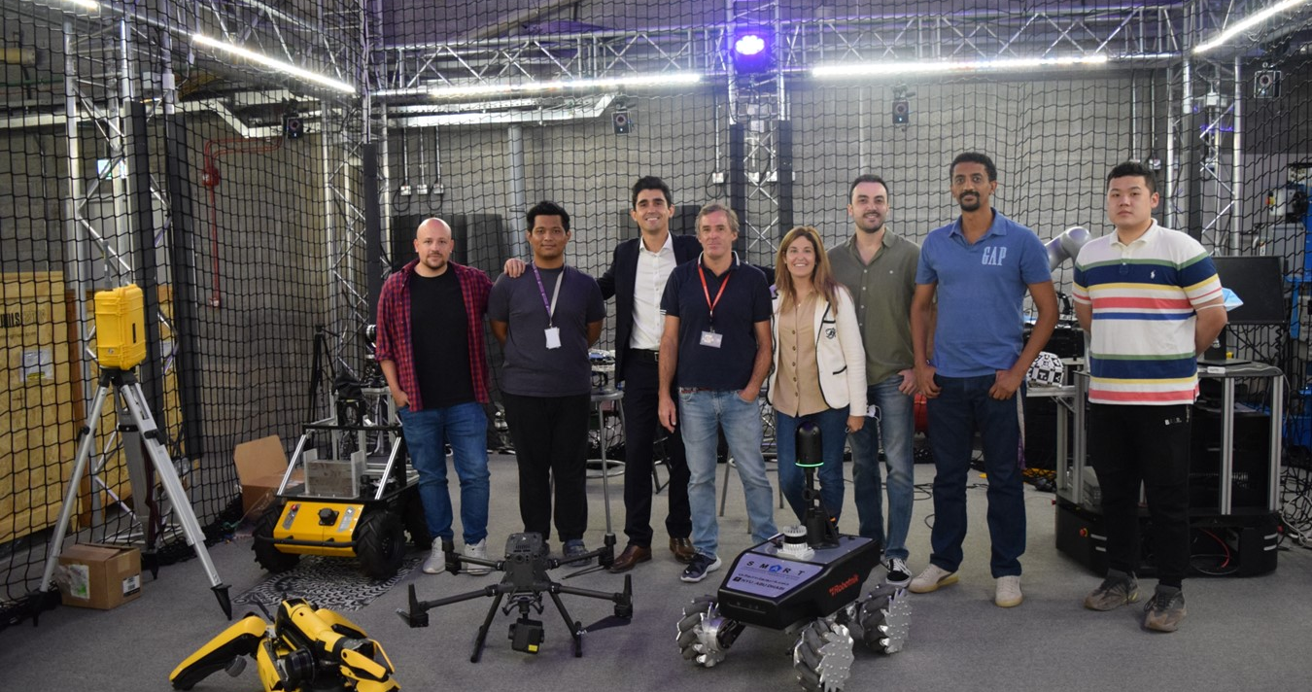




Overview
Our goal is to bridge scholarly excellence with practical application, optimizing every stage of the infrastructure lifecycle to build resilient future communities.
Sustainable and resilient construction
Introduction Smart
Construction
Modularization and lean construction
Research Group
Artificial intelligence
Borja García de Soto, PhD, PE
Robotic systems and automation
Technology integration & information modelling

Slide 2


Sustainable and resilient construction
Overview
Introduction Smart
Bio
Modularization and lean construction
Construction
Our goal is to bridge scholarly excellence with practical application, optimizing every stage of the infrastructure lifecycle to build resilient future communities.
Research Group
Dr. Borja Garcia DeSoto
Artificial intelligence
Associate Professor, NYU Abu Dhabi,
Driving digital twin research that links IoT sensing with BIM and AI to transform real-time data into predictive insights and scalable infrastructure optimization.
Borja García de Soto, PhD, PE
Robotic systems and automation
Technology integration & information modelling
Experience:
Moving research into real-world pilots.
Integrating IoT pipelines with enterprise systems.
Advancing twins from monitoring to optimization.
Creating value-driven, repeatable frameworks.

Slide 3

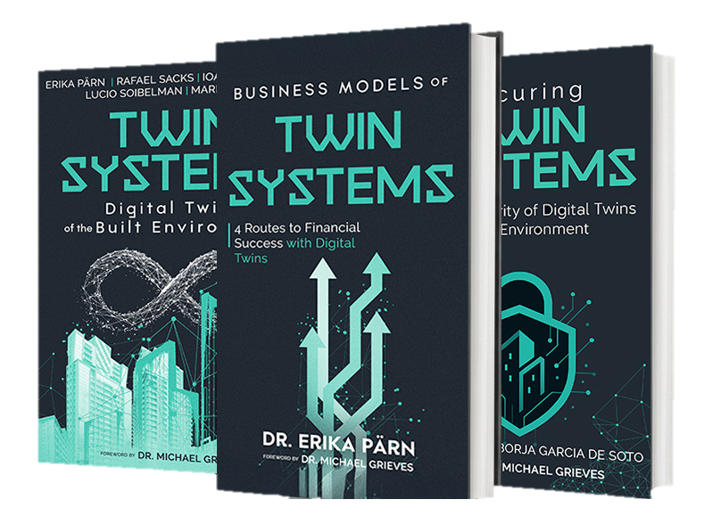
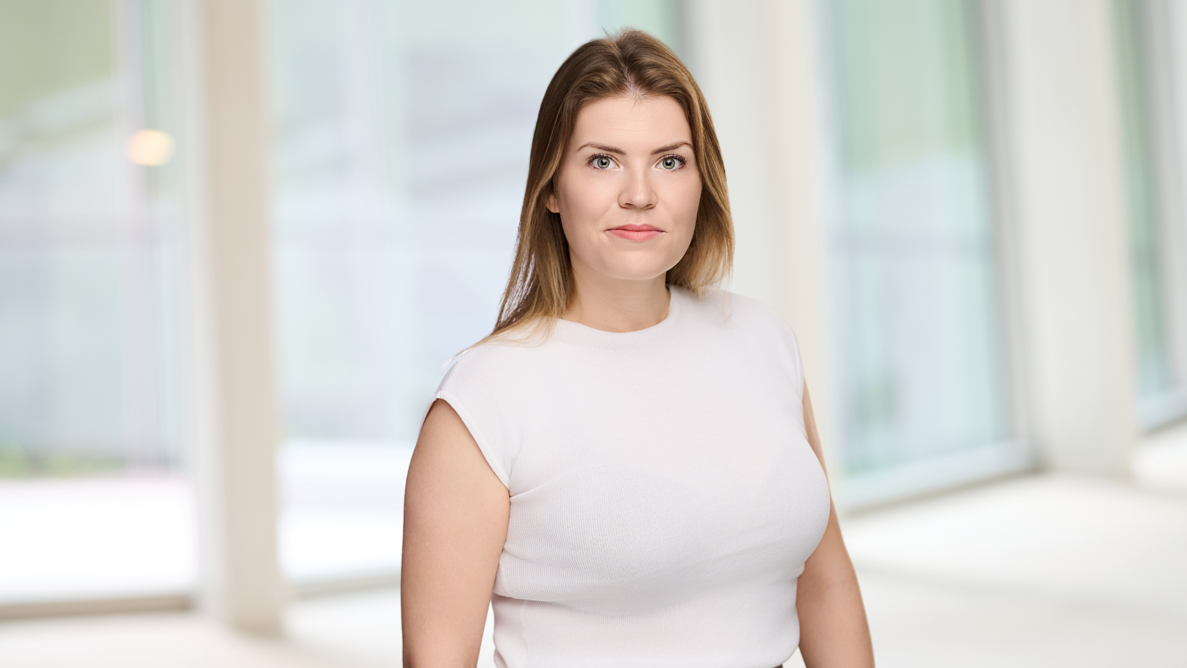
Overview
Our goal is to bridge scholarly excellence with practical application, optimizing every stage of the infrastructure lifecycle to build resilient future communities.
Bio
Sustainable and resilient construction
Dr. Erika Parn
Research Scientist at NYU Abu Dhabi and
Collaborator at the University of Cambridge.
Bio
Modularization and lean construction
Research into Digital Twins of the Built Environment and Business Value of Digital Twins and Cybersecurity of Digital Twins.
Dr. Borja Garcia DeSoto
Artificial intelligence
Associate Professor, NYU Abu Dhabi,
Driving digital twin research that links IoT sensing with BIM and AI to transform real-time data into predictive insights and scalable infrastructure optimization.
Experience:
Moving research into real-world pilots.
Integrating IoT pipelines with enterprise systems.
Advancing twins from monitoring to optimization.
Creating value-driven, repeatable frameworks.
Robotic systems and automation
Technology integration & information modelling
Experience:
Digital construction, BIM, Digital Twins, and cybersecurity.
Construction 4.0 and the built environment.
Data, automation, and intelligent systems.
Improving project management, asset performance, and infrastructure resilience.

Slide 4
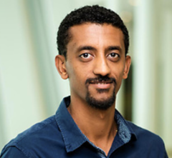
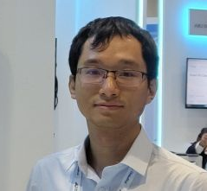
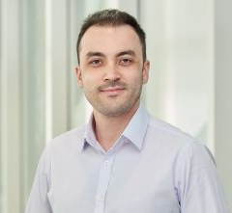
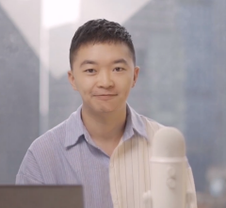
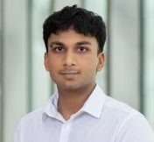

Research Team | people Of S.M.A.R.T. Labs
Bio
Dr. Erika Parn
Bio
Research Scientist at NYU Abu Dhabi and
Collaborator at the University of Cambridge.
Research into Digital Twins of the Built Environment and Business Value of Digital Twins and Cybersecurity of Digital Twins.
Dr. Borja Garcia DeSoto
Associate Professor, NYU Abu Dhabi,
Borja García De Soto
Eyob Mengiste
Erika A. Pärn
Zihao Zheng
Associate Professor
Instructor and Researcher
Research Scientist
Postdoctoral Associate
Driving digital twin research that links IoT sensing with BIM and AI to transform real-time data into predictive insights and scalable infrastructure optimization.
Experience:
Digital construction, BIM, Digital Twins, and cybersecurity.
Construction 4.0 and the built environment.
Data, automation, and intelligent systems.
Improving project management, asset performance, and infrastructure resilience.
Semih Sonkor
Dongchi (Daniel) Yao
Nas Gopee
Boyu Wang
PhD Student
Postdoctoral Associate
Research Assistant
Postdoctoral Associate
Experience:
Moving research into real-world pilots.
Integrating IoT pipelines with enterprise systems.
Advancing twins from monitoring to optimization.
Creating value-driven, repeatable frameworks.

Slide 5

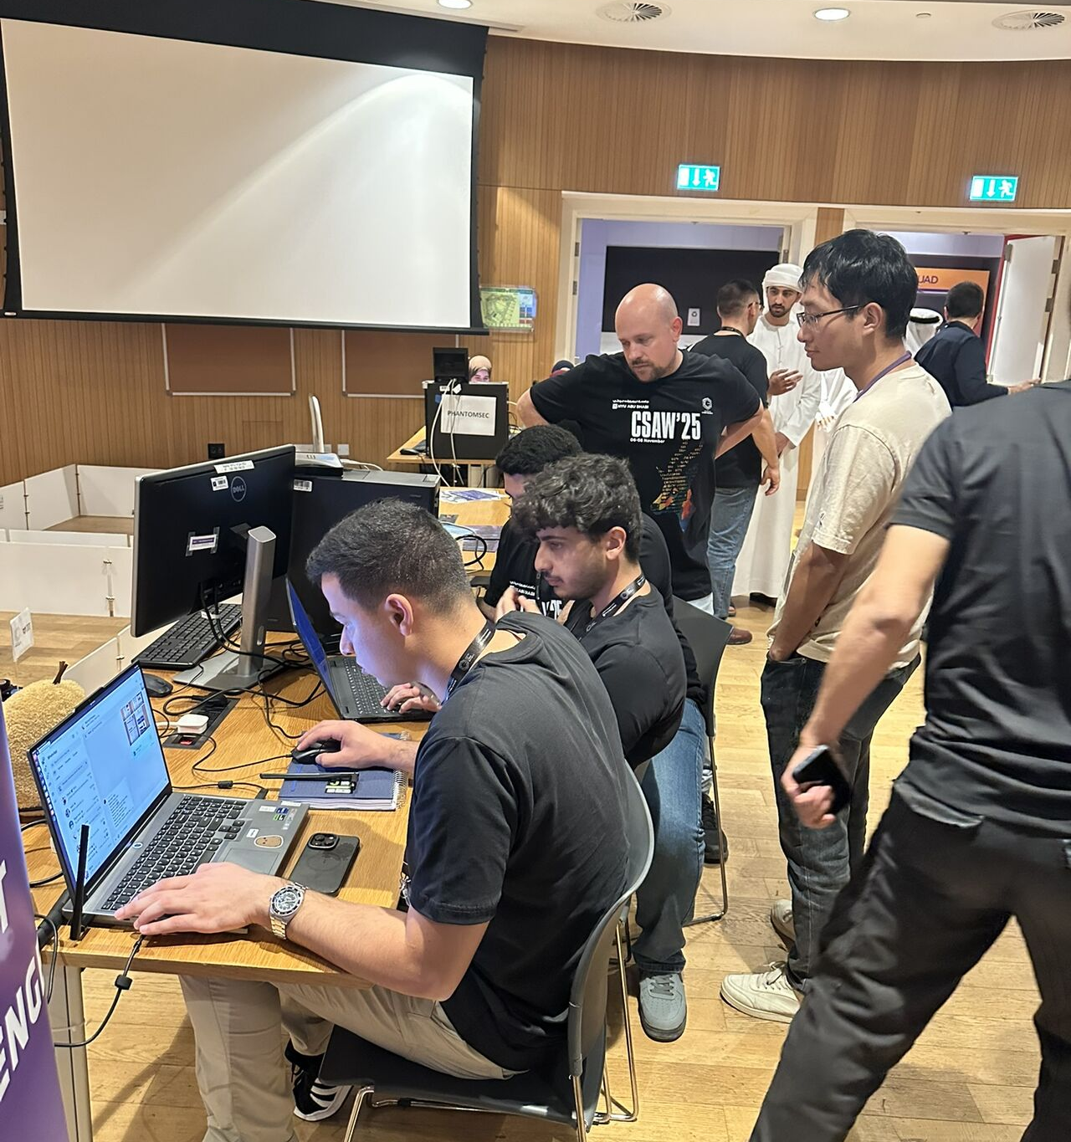

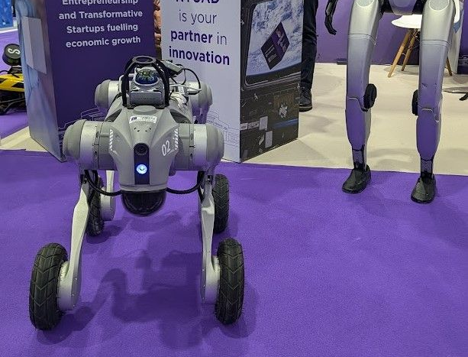
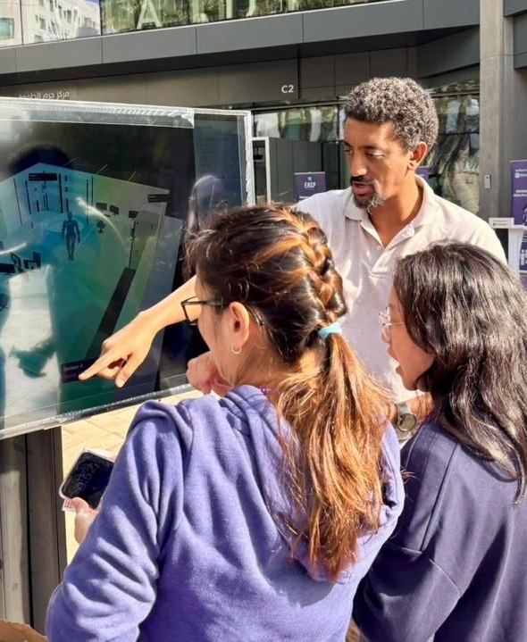

Bio
Research Team | people Of S.M.A.R.T. Labs
Artificial Intelligence
Cybersecurity
Crowdsourcing
Risk identification
Machine learning
Vulnerability assessment
Dr. Erika Parn
Research Scientist at NYU Abu Dhabi and
Collaborator at the University of Cambridge.
Overview Research| Focus of S.M.A.R.T.
Robotics
Research into Digital Twins of the Built Environment and Business Value of Digital Twins and Cybersecurity of Digital Twins.
Modularization
Robotics & AI
Autonomous reality capture
Progress monitoring
Inspection
Human-Robot Interaction
LLM integration
Borja García De Soto
Eyob Mengiste
Erika A. Pärn
Zihao Zheng
Associate Professor
Instructor and Researcher
Research Scientist
Postdoctoral Associate
Technology Integration
Sustainability
Data Analytics
Digital Twin
Data processing
Data visualization
Semih Sonkor
Dongchi (Daniel) Yao
Nas Gopee
Boyu Wang
PhD Student
Postdoctoral Associate
Research Assistant
Postdoctoral Associate
Experience:
Digital construction, BIM, Digital Twins, and cybersecurity.
Construction 4.0 and the built environment.
Data, automation, and intelligent systems.
Improving project management, asset performance, and infrastructure resilience.

Slide 6
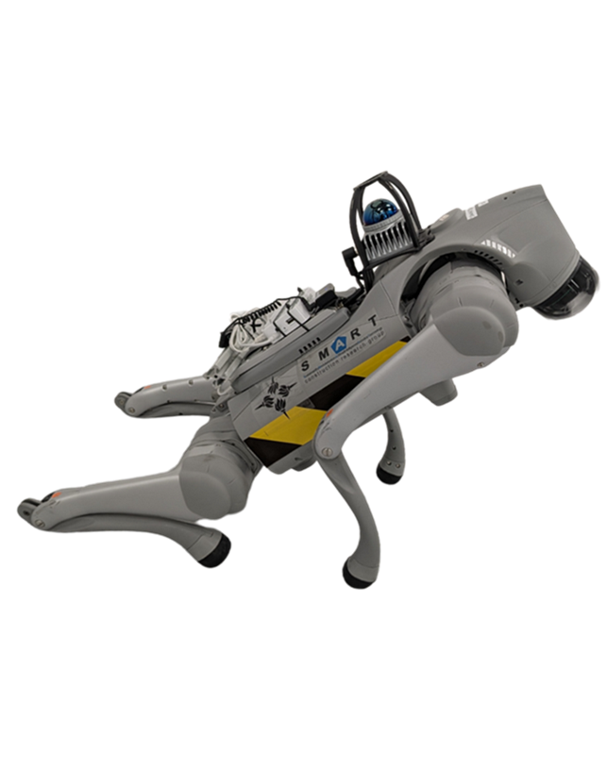

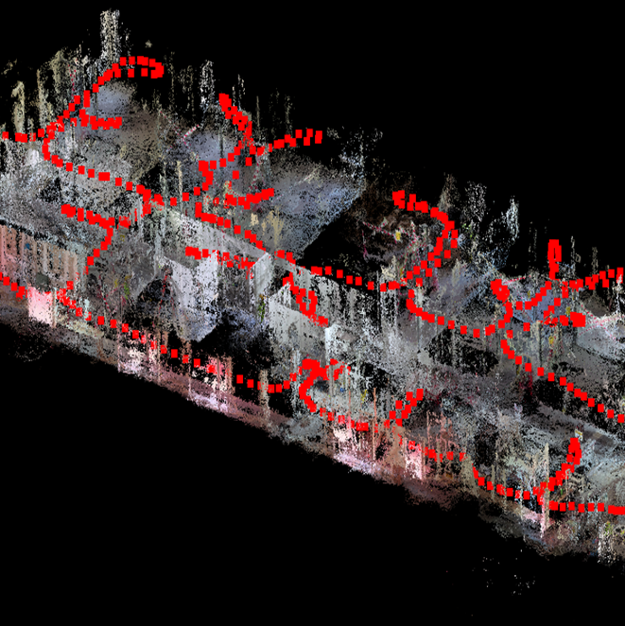
Areas Of Research Focus| 2026
Research Team | people Of S.M.A.R.T. Labs
Artificial Intelligence
Cybersecurity
Crowdsourcing
Risk identification
Machine learning
Vulnerability assessment
Overview Research| Focus of S.M.A.R.T.
Robotics
Modularization
Robotics & AI
Autonomous reality capture
Progress monitoring
Inspection
Human-Robot Interaction
LLM integration
Borja García De Soto
Eyob Mengiste
Erika A. Pärn
Zihao Zheng
Associate Professor
Instructor and Researcher
Research Scientist
Postdoctoral Associate
Technology Integration
Sustainability
Data Analytics
Digital Twin
Data processing
Data visualization
Semih Sonkor
Dongchi (Daniel) Yao
Nas Gopee
Boyu Wang
PhD Student
Postdoctoral Associate
Research Assistant
Postdoctoral Associate
Robotics
Cybersecurity
Technology Integration

Slide 7

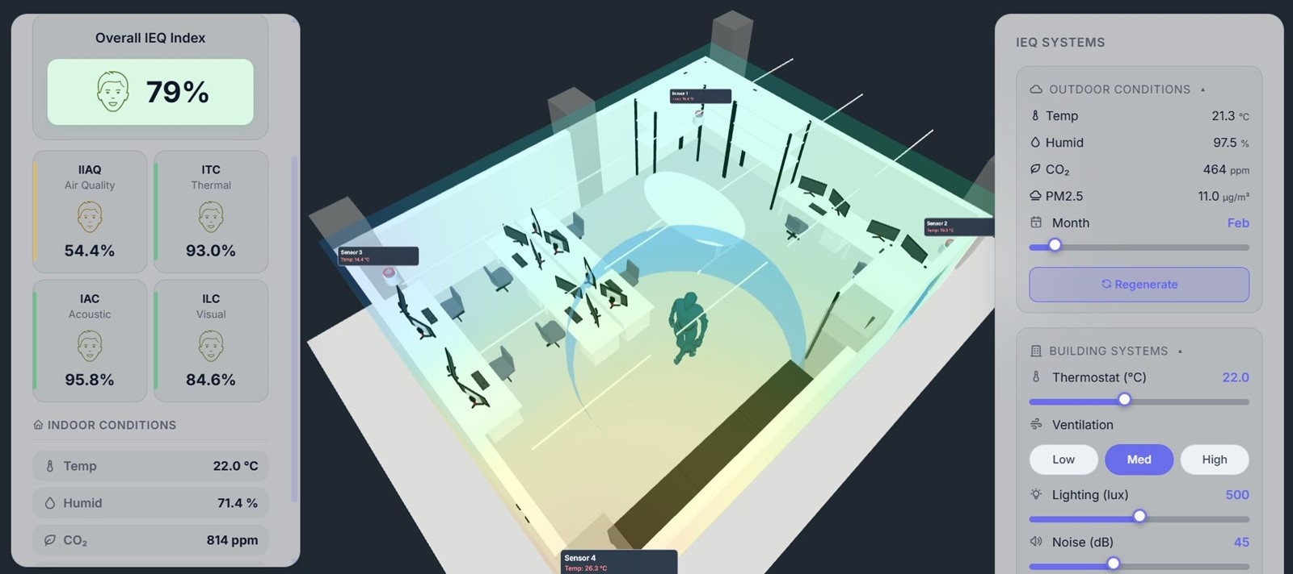
01
Areas Of Research Focus| 2026
Artificial Intelligence
Cybersecurity
Crowdsourcing
Risk identification
Machine learning
Vulnerability assessment
Overview Research| Focus of S.M.A.R.T.
Robotics
Cybersecurity
Technology Integration
Robotics
Modularization
Robotics & AI
Autonomous reality capture
Progress monitoring
Inspection
Human-Robot Interaction
LLM integration
Technology Integration
Sustainability
Data Analytics
Digital Twin
Data processing
Data visualization
AI & Tech Integration:
NYU CAMPUS DIGITAL TWIN

Slide 8
Areas Of Research Focus| 2026
01
AI & Tech Integration:
NYU CAMPUS DIGITAL TWIN
Robotics
Cybersecurity
Technology Integration

Slide 9



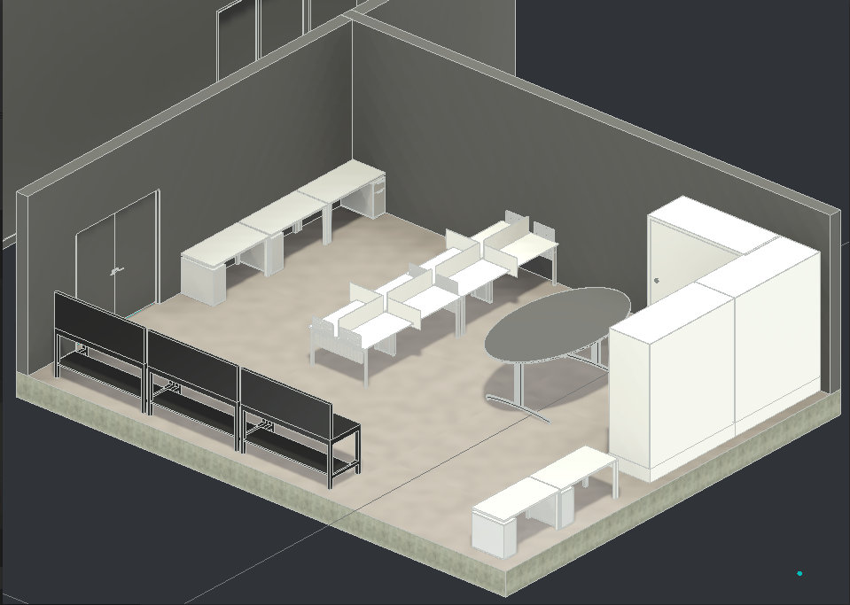
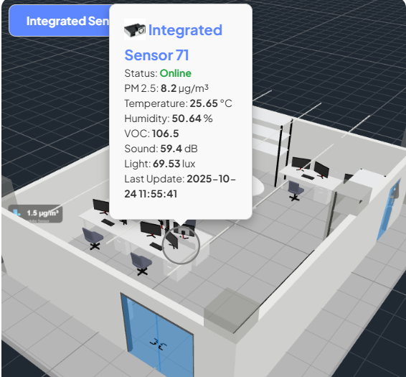
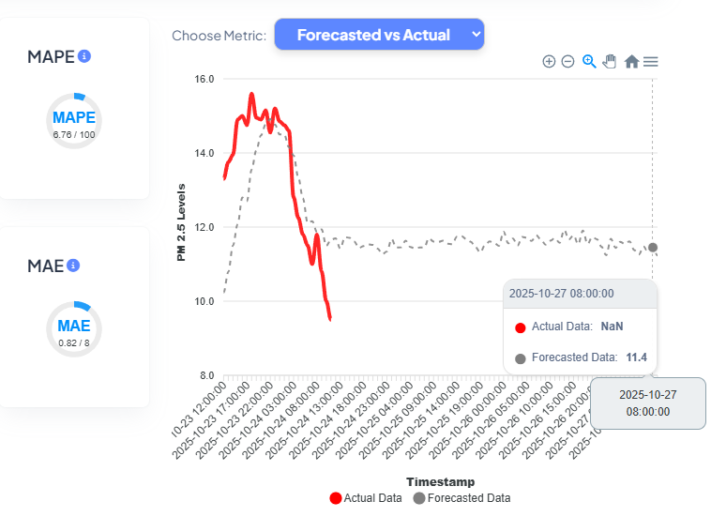


Our Digital Twin Maturity
01
Video
AI & Tech Integration:
NYU CAMPUS DIGITAL TWIN
What is a Digital Twin?
Digital Twinning
AI & Digital Twin
Scan Me
Digital Twin Maturity Level [1]:
Digital model
Digital Shadow
Digital Twin
Autonomous Digital Twin
Federated Digital Twin
[1] Mousavi, Y.; Gharineiat, Z.; Karimi, A.A.; McDougall, K.; Rossi, A.; Gonizzi Barsanti, S. Digital Twin Technology in Built Environment: A Review of Applications, Capabilities and Challenges. Smart Cities 2024, 7, 2594-2615. https://doi.org/10.3390/smartcities7050101
Building models
IoT sensors/CPS
Twin analytics
Future work

Slide 10
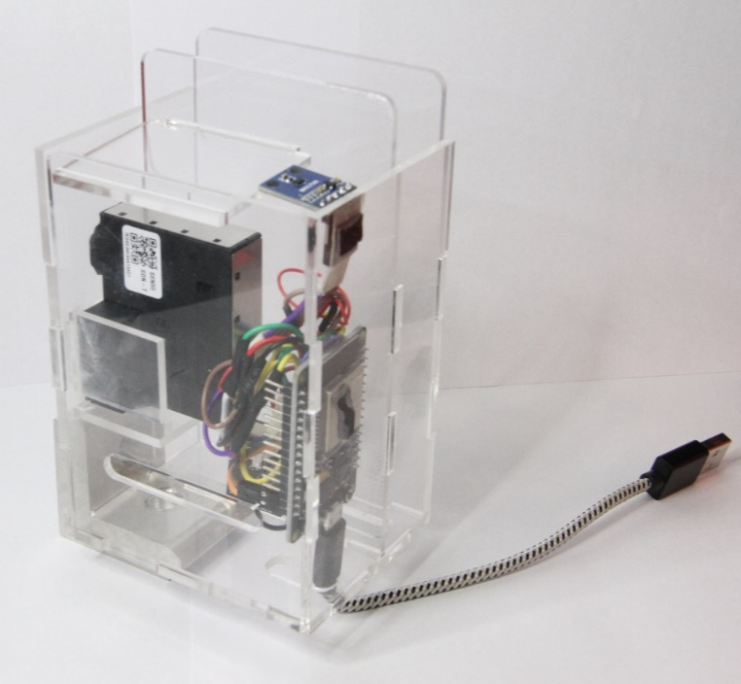


S.M.A.R.T. Digital Twin Platform
Our Digital Twin Maturity
What is a Digital Twin?
Digital Twinning
AI & Digital Twin
Scan Me
Digital Twin Maturity Level [1]:
Digital model
Digital Shadow
Digital Twin
Autonomous Digital Twin
Federated Digital Twin
Building models
IoT sensors/CPS
Twin analytics
Future work
[1] Mousavi, Y.; Gharineiat, Z.; Karimi, A.A.; McDougall, K.; Rossi, A.; Gonizzi Barsanti, S. Digital Twin Technology in Built Environment: A Review of Applications, Capabilities and Challenges. Smart Cities 2024, 7, 2594-2615. https://doi.org/10.3390/smartcities7050101
What is a Digital Twin?
Digital Twinning
AI & Digital Twin
Scan Me
Sensor types: Env. Sensor; Light Sensor; Noise Sensor
Data collection: PM 1, 2.5, 4, 10, temperature, humidity, air pressure, light intensity, sound, VOC, NOx, CO2
Parameter | Sampling Time | Range
Temperature | 60 s | -10 ~ 50 (°C)
Humidity |  | 0 ~ 90 (RH)
Particulate Material (PM 1, 2.5, 4, 10) |  | 0 ~ 1000 μg/m³
VOC |  | 0 ~ 500 VOC Index
Temperature | 60 s | -40 ~ 85 (°C)
Humidity |  | 0 ~ 100 (RH)
Decibel | 60 s | 30 ~ 130 (dBA)
Light Intensity | 60 s | 0 ~ 65535 (lux)
Sensor product prototype
NYU IoT Network
Database

Slide 11

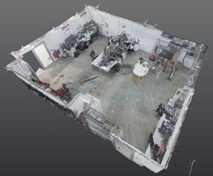
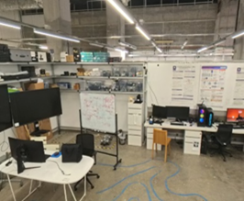
Our Digital Twin Maturity
S.M.A.R.T. Digital Twin Platform
S.M.A.R.T. Digital Twin Platform
What is a Digital Twin?
Digital Twinning
AI & Digital Twin
What is a Digital Twin?
Digital Twinning
AI & Digital Twin
BIM Model
Sensor types: Env. Sensor; Light Sensor; Noise Sensor
Data collection: PM 1, 2.5, 4, 10, temperature, humidity, air pressure, light intensity, sound, VOC, NOx, CO2
Parameter | Sampling Time | Range
Temperature | 60 s | -10 ~ 50 (°C)
Humidity |  | 0 ~ 90 (RH)
Particulate Material (PM 1, 2.5, 4, 10) |  | 0 ~ 1000 μg/m³
VOC |  | 0 ~ 500 VOC Index
Temperature | 60 s | -40 ~ 85 (°C)
Humidity |  | 0 ~ 100 (RH)
Decibel | 60 s | 30 ~ 130 (dBA)
Light Intensity | 60 s | 0 ~ 65535 (lux)
Scan Me
As-designed building information
Virtual models
Point Cloud
Updated room layout
High resolution visuals
Panorama Mode
Actual physical environment
Sensor product prototype
NYU IoT Network
Database
What is a Digital Twin?
Digital Twinning
AI & Digital Twin
Scan Me
Digital Twin Maturity Level [1]:
Digital model
Digital Shadow
Digital Twin
Autonomous Digital Twin
Federated Digital Twin
[1] Mousavi, Y.; Gharineiat, Z.; Karimi, A.A.; McDougall, K.; Rossi, A.; Gonizzi Barsanti, S. Digital Twin Technology in Built Environment: A Review of Applications, Capabilities and Challenges. Smart Cities 2024, 7, 2594-2615. https://doi.org/10.3390/smartcities7050101
Building models
IoT sensors/CPS
Twin analytics
Future work

Slide 12
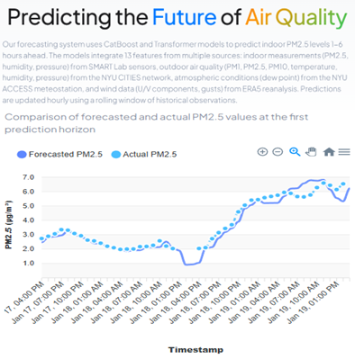
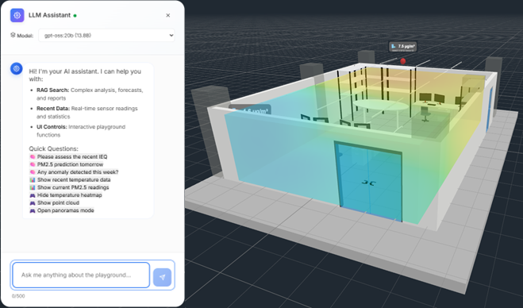
S.M.A.R.T. Digital Twin Platform
AI Applications in our Digital Twin
S.M.A.R.T. Digital Twin Platform
What is a Digital Twin?
Digital Twinning
AI & Digital Twin
What is a Digital Twin?
Digital Twinning
AI & Digital Twin
Video
BIM Model
Application 1:
Application 2:
As-designed building information
Virtual models
Indoor Air Quality Prediction
LLM-Assistant for Digital Twin
Point Cloud
Updated room layout
High resolution visuals
Panorama Mode
Actual physical environment
What is a Digital Twin?
Digital Twinning
AI & Digital Twin
Scan Me
Sensor types: Env. Sensor; Light Sensor; Noise Sensor
Data collection: PM 1, 2.5, 4, 10, temperature, humidity, air pressure, light intensity, sound, VOC, NOx, CO2
Parameter | Sampling Time | Range
Temperature | 60 s | -10 ~ 50 (°C)
Humidity |  | 0 ~ 90 (RH)
Particulate Material (PM 1, 2.5, 4, 10) |  | 0 ~ 1000 μg/m³
VOC |  | 0 ~ 500 VOC Index
Temperature | 60 s | -40 ~ 85 (°C)
Humidity |  | 0 ~ 100 (RH)
Decibel | 60 s | 30 ~ 130 (dBA)
Light Intensity | 60 s | 0 ~ 65535 (lux)
Sensor product prototype
NYU IoT Network
Database

Slide 13

02
AI Applications in our Digital Twin
S.M.A.R.T. Digital Twin Platform
What is a Digital Twin?
Digital Twinning
AI & Digital Twin
What is a Digital Twin?
Digital Twinning
AI & Digital Twin
BIM Model
Application 1:
Application 2:
As-designed building information
Virtual models
Indoor Air Quality Prediction
LLM-Assistant for Digital Twin
Point Cloud
Updated room layout
High resolution visuals
Panorama Mode
Actual physical environment
Robotics, Data Integration & Ai :
Smart Construction Data Integration

Slide 14












AI Applications in our Digital Twin
Existing Technologies Overview | Limitations
02
What is a Digital Twin?
Digital Twinning
AI & Digital Twin
Application 1:
Application 2:
General limitations
LLM-Assistant for Digital Twin
Indoor Air Quality Prediction
Ingestion breadth - docs, drawings, schedules, video, sensors.
Spatial grounding - room/zone, alignment to BIM, SLAM support
Progress accuracy - by trade/room
Explainability - evidence links per claim.
Prescription quality - concrete next steps, conflicts resolved.
Orchestration - automated routing to the right people/channels.
Latency - capture to decision forming decision time.
APIs/Export - data ownership, schema clarity.
Security/Deployment - on-premises, data residency.
Total cost of ownership - licenses + ops + change management.
Robotics, Data Integration & Ai :
Smart Construction Data Integration

Slide 15














Research Directions| Towards Multi Source Data
Existing Technologies Overview | Limitations
02
General limitations
Ingestion breadth - docs, drawings, schedules, video, sensors.
Spatial grounding - room/zone, alignment to BIM, SLAM support
Progress accuracy - by trade/room
Explainability - evidence links per claim.
Prescription quality - concrete next steps, conflicts resolved.
Orchestration - automated routing to the right people/channels.
Latency - capture to decision forming decision time.
APIs/Export - data ownership, schema clarity.
Security/Deployment - on-premises, data residency.
Total cost of ownership - licenses + ops + change management.
Robotics, Data Integration & Ai :
Smart Construction Data Integration
Multi-Source/
stakeholder data generation
Client - interests, revisions, approvals
Material supplier - specs delivery notes, delays, supply chain
Weather – rain, heat …
Multi-modal ingestion
Government Services – approvals
Subcontractors – performance, delivery, constraints
Consultant – orders
Site personnel – foreman's, workers and engineers
Context understanding Automation LLM explanations
Dynamic dashboards
Initial static/semi static documents
Recognition, Evaluation, Validation, Insight and Lookahead generation

Slide 16
Demo| Interactive Floorplan
Research Directions| Towards Multi Source Data
Existing Technologies Overview | Limitations
Multi-Source/
stakeholder data generation
Multi-modal ingestion
Context understanding Automation LLM explanations
Dynamic dashboards
Client - interests, revisions, approvals
General limitations
Ingestion breadth - docs, drawings, schedules, video, sensors.
Spatial grounding - room/zone, alignment to BIM, SLAM support
Progress accuracy - by trade/room
Explainability - evidence links per claim.
Prescription quality - concrete next steps, conflicts resolved.
Orchestration - automated routing to the right people/channels.
Latency - capture to decision forming decision time.
APIs/Export - data ownership, schema clarity.
Security/Deployment - on-premises, data residency.
Total cost of ownership - licenses + ops + change management.
Material supplier - specs delivery notes, delays, supply chain
Initial static/semi static documents
Weather – rain, heat …
Government Services – approvals
Subcontractors – performance, delivery, constraints
Consultant – orders
Recognition, Evaluation, Validation, Insight and Lookahead generation
Site personnel – foreman's, workers and engineers

Slide 17

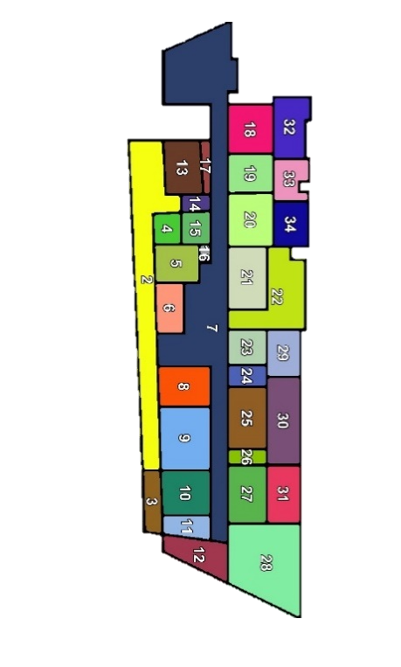
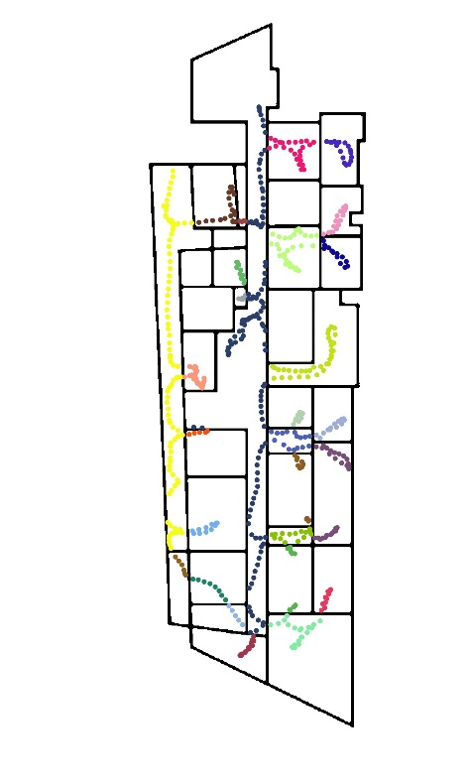
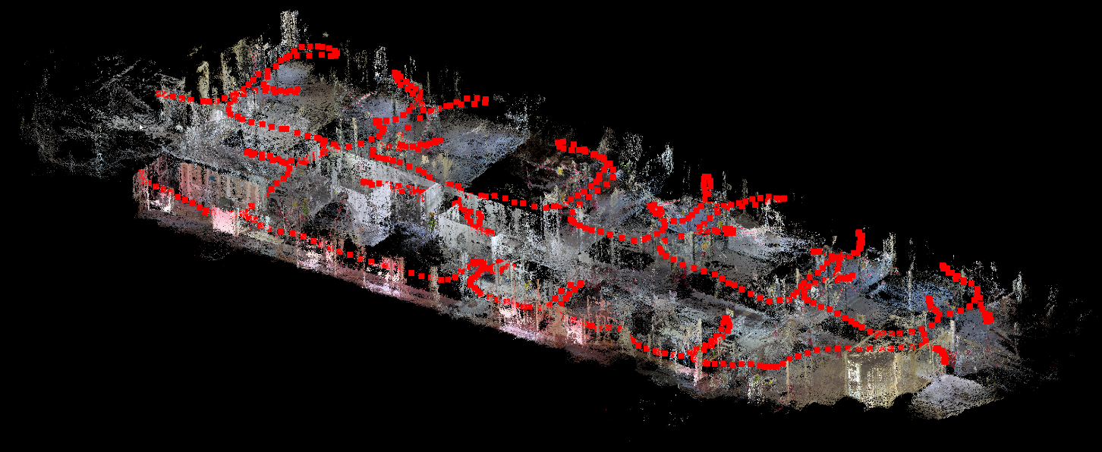
Research Directions| Towards Multi Source Data
Demo| Site Data Capture
Demo| Interactive Floorplan
Video
Multi-Source/
stakeholder data generation
Client - interests, revisions, approvals
Material supplier - specs delivery notes, delays, supply chain
Weather – rain, heat …
Multi-modal ingestion
Government Services – approvals
Subcontractors – performance, delivery, constraints
Consultant – orders
Site personnel – foreman's, workers and engineers
Context understanding Automation LLM explanations
Dynamic dashboards
Initial static/semi static documents
Recognition, Evaluation, Validation, Insight and Lookahead generation

Slide 18
Demo| Interactive Floorplan
Demo| Site Data Capture
Demo| Site Data Capture
Video of a person walking

Slide 19
03
Demo| Site Data Capture
Demo| Site Data Capture
Robotics & Ai: Human Computer Interaction In Construction

Slide 20
Demo| Site Data Capture
03
Robotics & AI: Human Computer Interaction In Construction

Slide 21
04
03
Video
Robotics & Ai: Human Computer Interaction In Construction

Slide 22
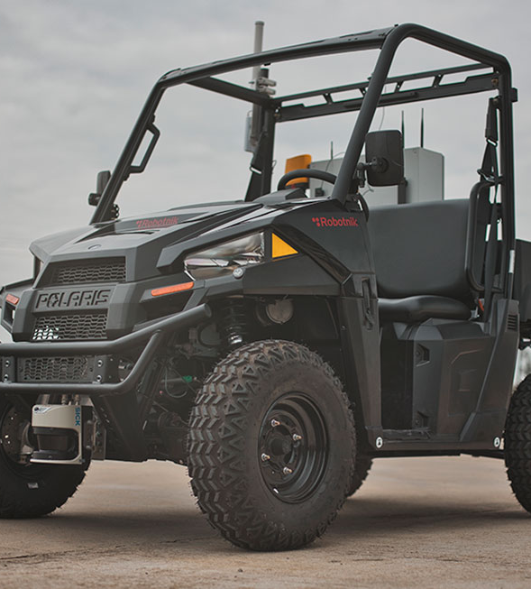
Ground Robots Autonomous Car Development Platform
04
Autonomous research Polaris RANGER buggy.
Modular sensor-equipped LiDAR, IMU, cameras, & GPS.
Robotics:
Access To Our Equipment
Autonomous navigation and multi-sensor experiments.
Ideal for rough-terrain environments

Slide 23
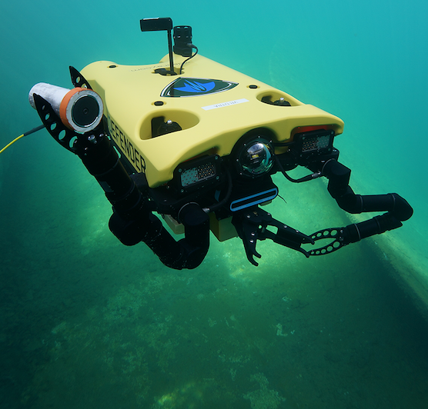
VideoRay Defender: 6-DOF control, modular, stable and robust operation
Ground Robots Autonomous Car Development Platform
04
Hydromea EXRAY: Wireless optical modems for collaborative use.
Precise 6-DOF control, high-definition imaging, modular payload integration
Autonomous research Polaris RANGER buggy.
Modular sensor-equipped LiDAR, IMU, cameras, & GPS.
Robotics:
Access To Our Equipment
Remotely Operated Vehicles Underwater Platforms
Underwater asset inspection, maintenance, and environmental monitoring.
Autonomous navigation and multi-sensor experiments.
Ideal for rough-terrain environments

Slide 24
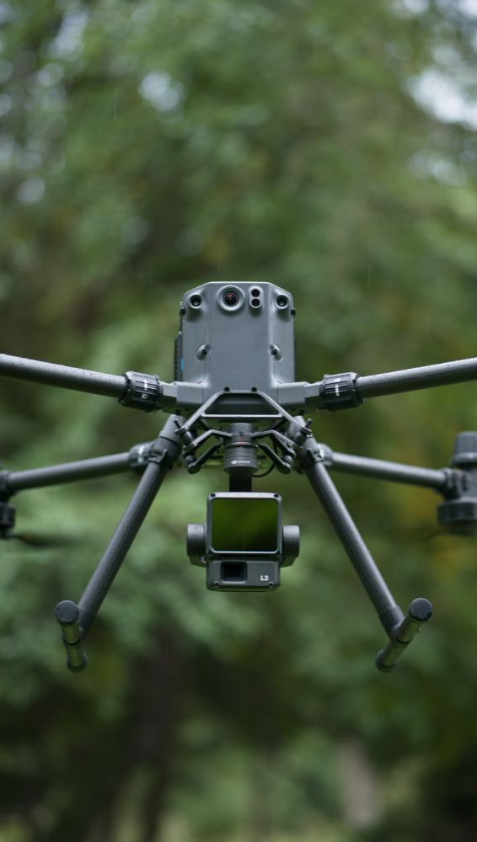
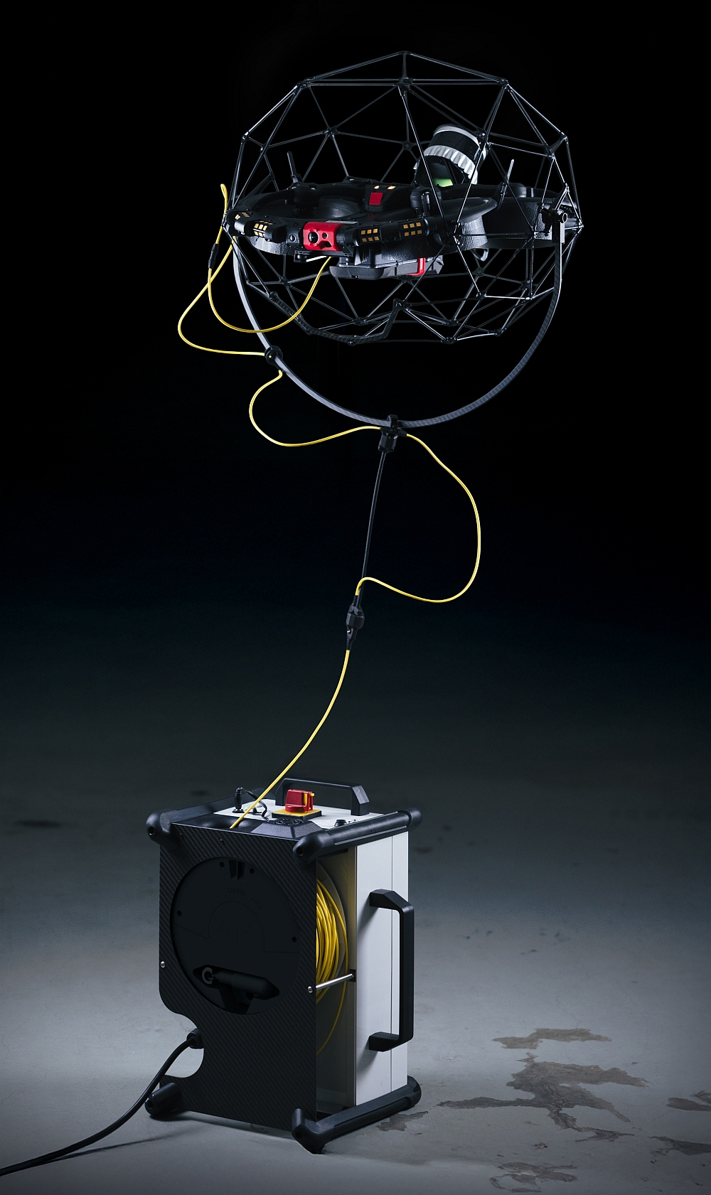
Aerial Platforms Unmanned Aerial Vehicles (Uavs)
Ground Robots Autonomous Car Development Platform
VideoRay Defender: 6-DOF control, modular, stable and robust operation
Hydromea EXRAY: Wireless optical modems for collaborative use.
DJI Matrice 300 RTK: industrial drone, RTK precision, 55 min flight time, modular payload (LiDAR, thermal, RGB, hyperspectral)
Precise 6-DOF control, high-definition imaging, modular payload integration
Autonomous research Polaris RANGER buggy.
Flyability Elios 3 (being procured): collision-tolerant indoor drone, equipped with LiDAR and modular payloads.
Modular sensor-equipped LiDAR, IMU, cameras, & GPS.
Remotely Operated Vehicles Underwater Platforms
Underwater asset inspection, maintenance, and environmental monitoring.
Autonomous navigation and multi-sensor experiments.
Both indoor and outdoor operation, used for asset monitoring, inspection, and data collection in hard to reach areas

Slide 25

05
Aerial Platforms Unmanned Aerial Vehicles (Uavs)
VideoRay Defender: 6-DOF control, modular, stable and robust operation
Hydromea EXRAY: Wireless optical modems for collaborative use.
DJI Matrice 300 RTK: industrial drone, RTK precision, 55 min flight time, modular payload (LiDAR, thermal, RGB, hyperspectral)
Precise 6-DOF control, high-definition imaging, modular payload integration
Flyability Elios 3 (being procured): collision-tolerant indoor drone, equipped with LiDAR and modular payloads.
Remotely Operated Vehicles Underwater Platforms
Underwater asset inspection, maintenance, and environmental monitoring.
Both indoor and outdoor operation, used for asset monitoring, inspection, and data collection in hard to reach areas
Cybersecurity: Risk Management Of Cyber Incidents In Construction

Slide 26
Aerial Platforms Unmanned Aerial Vehicles (Uavs)
05
DJI Matrice 300 RTK: industrial drone, RTK precision, 55 min flight time, modular payload (LiDAR, thermal, RGB, hyperspectral)
Flyability Elios 3 (being procured): collision-tolerant indoor drone, equipped with LiDAR and modular payloads.
Cybersecurity: Risk Management Of Cyber Incidents In Construction
Both indoor and outdoor operation, used for asset monitoring, inspection, and data collection in hard to reach areas

Slide 27
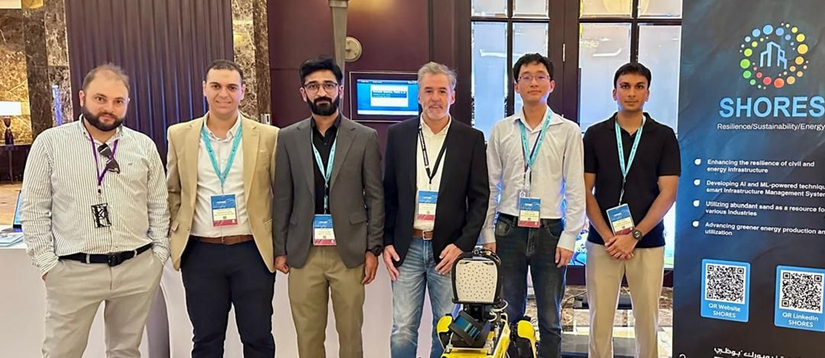
06
05
Video
Cybersecurity: Risk Management Of Cyber Incidents In Construction
Industry Engagement Options

Slide 28
Collaboration Roadmap
 | Immediately 2-3 days | Short term 3-6 months | Short term 3-6 months | Long term 4-5 yrs
Method | Phone call, meeting | Consulting project with academics | 4th year projects, grants | Grants
Engaging NYUAD resources | Academics, researchers | Academics, researchers, Masters students | Undergraduates, academics, researchers Masters students, | PhD students, Academics, researchers
NYUAD in-kind support |  | Supervision time | Equipment (robotics, drones) & Supervision time | Equipment (robotics, drones) & Supervision time
06
Industry Engagement Options

Slide 29



06
Collaboration Roadmap
Collaboration Roadmap
 | Immediately 2-3 days | Short term 3-6 months | Short term 3-6 months | Long term 4-5 yrs
Method | Phone call, meeting | Consulting project with academics | 4th year projects, grants | Grants
Engaging NYUAD resources | Academics, researchers | Academics, researchers, Masters students | Undergraduates, academics, researchers Masters students, | PhD students, Academics, researchers
NYUAD in-kind support |  | Supervision time | Equipment (robotics, drones) & Supervision time | Equipment (robotics, drones) & Supervision time
Advisory & Strategy
Living Lab Pilots
National Innovation Centre
PHASE 01 — SHORT TERM
PHASE 02 — MEDIUM TERM
PHASE 03 — LONG TERM
Expert deployment for Digital Twin feasibility studies.
Testing Twin algorithms for national rollout via testbeds.
Establishing a joint CoE for sovereign IP and talent.
Industry Engagement Options

Slide 30


Scope of Collaboration
Collaboration Roadmap
Collaboration Roadmap
 | Immediately 2-3 days | Short term 3-6 months | Short term 3-6 months | Long term 4-5 yrs
Method | Phone call, meeting | Consulting project with academics | 4th year projects, grants | Grants
Engaging NYUAD resources | Academics, researchers | Academics, researchers, Masters students | Undergraduates, academics, researchers Masters students, | PhD students, Academics, researchers
NYUAD in-kind support |  | Supervision time | Equipment (robotics, drones) & Supervision time | Equipment (robotics, drones) & Supervision time
Advisory & Strategy
Living Lab Pilots
National Innovation Centre
PHASE 01 — SHORT TERM
PHASE 02 — MEDIUM TERM
PHASE 03 — LONG TERM
Expert deployment for Digital Twin feasibility studies.
Testing Twin algorithms for national rollout via testbeds.
Establishing a joint CoE for sovereign IP and talent.
NYUAD Solution
(12-Month Programme)
Three-month architecture and value definition.
Nine-month living-lab operational impact.
Scalable blueprint for digital ecosystems.
Months 1–3:
Strategy, Value & Blueprint
Diagnostic stakeholder gap analysis.
Value models and KPI definition.
Integration, governance, and operating models.
Five-year scalable executive masterplan.
Months 4–12:
Pilot Testing & Living Labs
Prioritize zones and success metrics
Deploy pipelines and twin dashboards.
Iterate algorithms with end users.
Finalize ROI and rollout playbooks.

Slide 31
Scope of Collaboration
Collaboration Roadmap
THANK YOU
NYUAD Solution
Months 1–3:
Months 4–12:
(12-Month Programme)
Strategy, Value & Blueprint
Pilot Testing & Living Labs
Three-month architecture and value definition.
Nine-month living-lab operational impact.
Scalable blueprint for digital ecosystems.
Diagnostic stakeholder gap analysis.
Value models and KPI definition.
Integration, governance, and operating models.
Five-year scalable executive masterplan.
Prioritize zones and success metrics
Deploy pipelines and twin dashboards.
Iterate algorithms with end users.
Finalize ROI and rollout playbooks.
Borja García de Soto, PhD, PE
Associate Professor
garcia.de.soto@nyu.edu
Advisory & Strategy
Living Lab Pilots
National Innovation Centre
PHASE 01 — SHORT TERM
PHASE 02 — MEDIUM TERM
PHASE 03 — LONG TERM
Expert deployment for Digital Twin feasibility studies.
Testing Twin algorithms for national rollout via testbeds.
Establishing a joint CoE for sovereign IP and talent.

Slide 32
Scope of Collaboration
THANK YOU
Borja García de Soto, PhD, PE
Associate Professor
garcia.de.soto@nyu.edu
NYUAD Solution
(12-Month Programme)
Three-month architecture and value definition.
Nine-month living-lab operational impact.
Scalable blueprint for digital ecosystems.
Months 1–3:
Strategy, Value & Blueprint
Diagnostic stakeholder gap analysis.
Value models and KPI definition.
Integration, governance, and operating models.
Five-year scalable executive masterplan.
Months 4–12:
Pilot Testing & Living Labs
Prioritize zones and success metrics
Deploy pipelines and twin dashboards.
Iterate algorithms with end users.
Finalize ROI and rollout playbooks.

